Slide 1
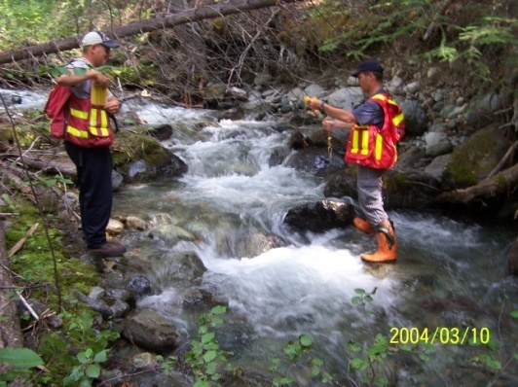
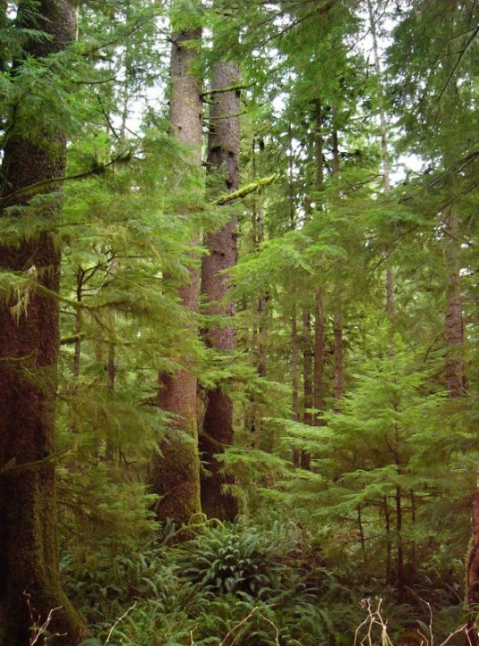

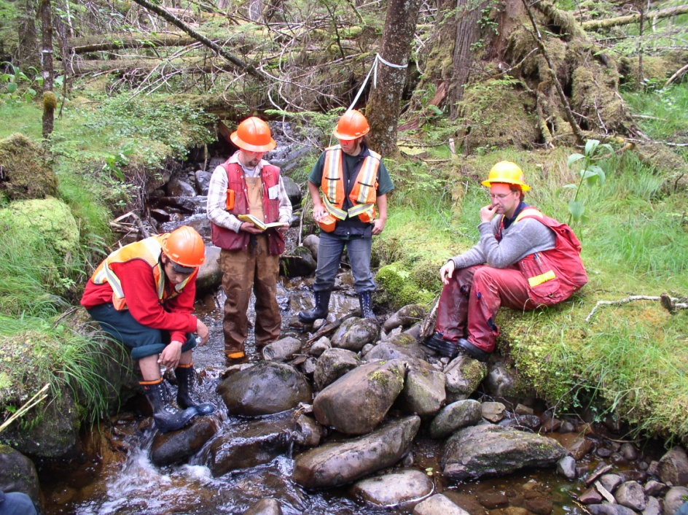
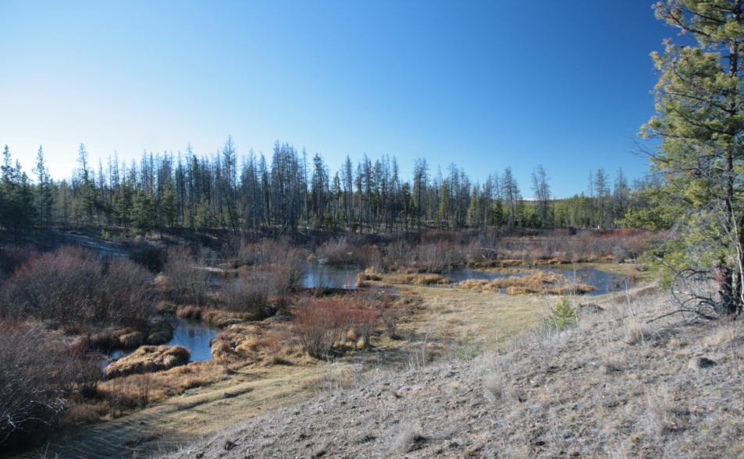
Riparian Management Effectiveness Evaluations
2005 - 2014
Peter J. Tschaplinski
Ministry of Environment

Slide 2
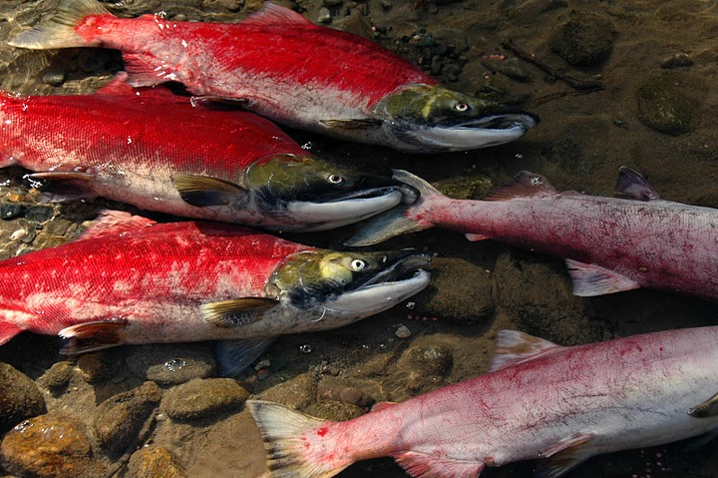
Riparian Management
Evaluation Question - Streams
Are riparian forestry and range practices effective in maintaining the structural integrity and functions of stream ecosystems over both short and long terms?

Slide 3
FREP Resource Stewardship Monitoring
RSM Riparian-Stream Assessment Protocol
  Developed and tested more than 12 years ago to meet the requirement to monitor under FRPA - a fundamental part of the results-based regime
  Indicator based
  15 indicators addressed by 15 main questions covering attributes and processes
Refined from an initial compilation of 61 potential indicators.
  Based on results from research and monitoring projects in different areas of the province and expert input
The resultant “condition” rating is based on the number of negative responses given to 15 main questions that cover four categories:
  Channel, Biological
  Channel, Physical
  Riparian, Biological
  Riparian, Physical

Slide 4
Stream-Riparian Indicators
1. Channel bed disturbance
2. Channel bank disturbance
3. LWD characteristics
4. Channel morphology
5. Aquatic connectivity
6. Fish cover diversity
7. Moss abundance & condition
8. Fine sediments
9. Aquatic invertebrate
diversity
10. Windthrow frequency
11. Riparian soil disturbance/
bare ground
12. LWD supply/root network
13. Shade & microclimate
14. Disturbance-increasers/
noxious weeds/invasive
plants
15. Vegetation form, vigour,
& structure

Slide 5
The Concept of
“Properly Functioning Condition”
Defined as the ability of a stream, river, wetland or lake and its riparian area to:
1. withstand normal peak flood events without experiencing
accelerated soil loss, channel movement, or bank movement;
2. filter runoff;
3. store and safely releases water;
4. maintain the connectivity of fish habitats in streams and riparian
areas so that these habitats are not lost or isolated as a result of
management activity;
5. maintain an adequate riparian root network or large woody debris
(LWD) supply; and
6. provide shade and reduce bank microclimate change.

Slide 6
Evaluation
Site assessments vary, based on stream morphology (riffle-pool, cascade-pool, step-pool, non-alluvial channels) and fish use
114 – 120 measurements, estimates, and observations required to complete a stream-riparian assessment based on 38 – 60 specific indicators
Each of 15 main questions answered “Yes = OK”, N/A, or “No = Problem”
Roll-up score = overall site condition
Number of Negative Responses (out of 15 Indicator Questions) | Condition Ranking
0 - 2 | Properly functioning
3 - 4 | Functioning, but at risk (limited impacts)
5 - 6 | Functioning, but at high risk (intermediate impacts)
> 6 | Not properly functioning

Slide 7
10-Year FREP Sample
2005 – 2014 Surveys
Forest Management Era | Riparian Class (S1–S6) with Average Stream Width (m)
 | Fish-Bearing |  |  |  | Without Fish
 | S1 > 20 m | S2 > 5 to ≤ 20 m | S3 1.5 to ≤ 5 m | S4 < 1.5 m | S5 > 3 m | S6 ≤ 3 m | Total
Forest Practices Code 1996 – 2003 | 3 | 54 | 230 | 210 | 63 | 511 | 1,092
Transition 2004 – 2006 | 5 | 42 | 121 | 100 | 48 | 314 | 609
Forest and Range Practices Act 2007 – 2014 | 1 | 41 | 132 | 70 | 56 | 286 | 586
ALL | 9 | 137 | 483 | 380 | 167 | 1,111 | 2,287

Slide 8
Provincial Summary of Post-harvest Stream-Riparian Condition Assessments by Forest Management Era
Notes:
Few tends across forest management eras.
About 12% of assessed sites were NPF
Sites in the top 2 categories varied from 66-68% across the 3 periods; i.e., were similar
Increase in top PFC category in the FRPA era is statistically significant

Slide 9
Stream/Riparian Condition by Stream Class 2005 – 2014
Notes:
Most; i.e., 71% of 282 NPF streams were in class S6
16 % of NPFs were class S4, so 87% of NPF streams were in class S4 and S6 combined
Some were classes S3 (7%; windthrow) and S5 (5%)
43% of class S6s in lower 2 outcomes; 57% in the top 2
33% of class S4s in lower 2 outcomes; 67% in the top 2
16% of fish bearing streams were in lower 2 outcomes; 84% in the top 2

Slide 10
Percent Outcomes in the Two Top PFC Categories vs. (PFC-I)+NPF and NPF
Riparian Class |  | FP Code Era (1996–2003) |  |  | Transition Era (2004–2006) |  |  | FRPA Era (2007–2014)
 |  | PFC+ PFC-L | PFC-I + NPF | NPF | PFC+ PFC-L | PFC-I + NPF | NPF | PFC+ PFC-L | PFC-I + NPF | NPF
Fish-Bearing | S1 | 100 | 0 | 0 | 80.0 | 20.0 | 0 | 100 | 0 | 0
 | S2 | 82.4 | 17.6 | 1.8 | 87.2 | 12.8 | 0 | 80.5 | 19.5 | 2.4
 | S3 | 83.2 | 16.8 | 5.2 | 79.8 | 20.2 | 5.9 | 88.6 | 11.4 | 1.5
 | S4 | 69.1 | 30.9 | 10.7 | 66.6 | 33.3 | 13.5 | 61.4 | 38.6 | 12.9
 | ALL | 77.3 | 22.7 | 7.1 | 76.1 | 23.9 | 7.7 | 79.5 | 20.5 | 4.9
Without Fish | S5 | 78.1 | 21.9 | 6.3 | 80.8 | 19.2 | 4.3 | 67.9 | 32.1 | 12.5
 | S6 | 58.4 | 41.6 | 18.6 | 55.4 | 44.6 | 16.5 | 56.6 | 43.4 | 18.9
 | ALL | 60.6 | 39.4 | 17.2 | 58.9 | 41.1 | 14.9 | 58.5 | 41.5 | 17.8
Notes:
Outcomes for class S3s have improved from the FPC to the FRPA showing 17-20% in the 2 lower outcomes vs 11% during FRPA
S5 outcomes have trended in the other direction going from 19-22% in the lower 2 outcomes prior to FRPA to 32% during FRPA. Sample size is small (FRPA n=57 and overall sample is 167)
Trends for other stream classes were not significant across management eras
S4s ranged between 61-69% in top 2 categories; 31-39% in lower 2
S6s ranged between 55-58% in top 2 categories and 42-45% in the lower 2

Slide 11
Post-harvest Outcomes by Region and Forest Management Era
Geographic Area | Forest Management Era | Sample (n) | Post-Harvest Stream-Riparian Condition (Percent of Assessed Stream Reaches)
 |  |  | PFC | PFC-L | PFC-I | NPF
Coast | FPC | 231 | 34.2 | 22.5 | 25.5 | 17.7
 | Transition | 178 | 32.0 | 26.4 | 23.6 | 18.0
 | FRPA | 188 | 35.6 | 23.9 | 21.8 | 18.6
 | ALL | 597 | 34.0 | 24.1 | 23.8 | 18.1
North | FPC | 469 | 33.7 | 36.5 | 19.0 | 10.9
 | Transition | 181 | 30.9 | 37.0 | 20.4 | 11.6
 | FRPA | 238 | 46.2 | 29.8 | 13.4 | 10.5
 | ALL | 888 | 36.5 | 34.8 | 17.8 | 10.9
South | FPC | 392 | 44.4 | 28.6 | 15.6 | 11.5
 | Transition | 250 | 46.0 | 24.4 | 22.0 | 7.6
 | FRPA | 160 | 43.1 | 20.0 | 28.8 | 8.1
 | ALL | 802 | 40.4 | 25.6 | 20.2 | 9.6
Notes:
Higher percentages of NPF outcomes occurred in the Coast Area (18 – 19%) compared to the two Interior areas (8 – 12%) across all forest management eras and assessed streams
May reflect mgmt. challenges in the steeper terrain and higher precipitation regimes and higher stream densities typical of coastal watersheds.
Few distinct patterns:
PFC percentages in top category generally higher in the South than in the North and Coast Areas
But, PFC outcomes in the North increased to 46% in the FRPA era from 31-34% in earlier years
In the South NPF streams declined sequentially from 12 to 8% from the FPC to the FRPA era

Slide 12
BROAD IMPACT CATEGORIES
Percent of “No” Answers
Activities or Factors Causing “No” Answers | Coast Area | North Area | South Area | Total
Logging | 71 (2.8) | 42 (1.5) | 42 (1.4) | 50 (1.8)
Natural factors | 14 (0.6) | 37 (1.3) | 30 (1.0) | 28 (1.0)
Roads | 9 (0.3) | 13 (0.5) | 12 (0.4) | 11 (0.4)
Livestock (cattle) | 0 (0.0) | 0 (0.0) | 7 (0.2) | 3 (0.1)
Upstream factors | 4 (0.2) | 8 (0.3) | 8 (0.2) | 7 (0.2)
Other human factors | 1 (0.1) | 1 (<0.1) | 1 (<0.1) | 1 (<0.1)
All Factors | 100 (4.0) | 100 (3.5) | 100 (3.3) | 100 (3.6)
Numbers in brackets = average number of “No” answers
Notes:
Impact categories were ranked on the basis of the frequency each category was attributed to have caused a “no” answer to a main question.

Slide 13
Percent of “No” Answers Due to Specific Logging Factors (2005-2014)
Logging Impacts | Coast Area | North Area | South Area | All Areas
Falling and yarding | 36 | 11 | 11 | 18
Windthrow | 12 | 16 | 17 | 15
Low riparian tree retention | 17 | 12 | 11 | 13
Old (previous) logging | 3 | 1 | 1 | 2
Machine disturbance, harvesting | 2 | 1 | 1 | 1
Slides/sloughs | 2 | 0 | 0 | 1
Watercourse diverted | 1 | 0 | 0 | < 1
Notes:
In descending order, falling and yarding, windthrow, and low riparian retention were the 3 greatest specific impact sources relating to logging in all areas combined
Account for most of the logging related alterations.
Falling and yarding and low retention made up 53% of all logging related impact sources in the Coast area while windthrow added another 12%
The remaining impact sources were the only ones scoring at least 1 % in any of the geographic areas.

Slide 14
Percent of “No” Answers Due to Specific Natural Characteristics or Disturbances (2005 ̶ 2014)
 | Coast Area | North Area | South Area | All Areas
Natural Impacts
High natural background sediments | 3 | 12 | 9 | 8
Wind | 4 | 8 | 6 | 6
Torrents | 4 | 3 | 4 | 4
Organic stream bed | 1 | 3 | 2 | 2
Floods | 0 | 3 | 2 | 2
Beetle kills | 0 | 2 | 3 | 2
Slides/sloughs (mass wasting) | 2 | 1 | 1 | 1
Stream dammed (beavers) | 0 | 2 | 1 | 1
Fire | 0 | 0 | 2 | 1
Trampling (ungulates) | 0 | 1 | 1 | 1
Notes:
Second highest source of impacts provincially
High background levels of fine sediments dominant in the interior ranging from 9% in the South Area to 12% in the North followed by wind (6 – 8%).
Wind and torrents were the leading causal factors on the Coast (4% each), followed by fine sediments (3%).
In general, a wider range of natural impacts were recorded for North and South Area streams compared to the Coast Area although the various sources made up 2% or less of the total number of attributed impacts

Slide 15
Percent of “No” Answers Due to Specific Road and Livestock Factors (2005 ̶ 2014)
 | Coast Area | North Area | South Area | All Areas
Road Impacts
Road surface erosion issues | 4 | 7 | 6 | 6
Ditch/fill/cut slope erosion issues | 4 | 5 | 5 | 5
Culvert issues | 0 | 1 | 1 | 1
Livestock Impacts
Trampling | 0 | 0 | 6 | 2
Excessive grazing/browsing | 0 | 0 | 1 | < 1
Notes:
Road related impacts summed over all specific causes varied from 8 to 13% as the cause of “no” answers among the 3 geographic areas
About equally divided between road surface erosion and ditch & cut-fill slope issues
Livestock issues were mainly about trampling of the stream bed and banks, and primarily in the South Area

Slide 16
Mean Number of “No” Answers to 15 Main Indicator Questions Due to Site-Level (Cutblock) Forestry vs. Other Factors
Stream class | Forest Management Era
 | FP Code Era (1996-2003) |  | Transition Era (2004-2006) |  | FRPA Era (2007-2014) |  | All Eras
 | Site-level Forestry | Other | Site-level Forestry | Other | Site-level Forestry | Other | Site-level Forestry | Other
S1 | 1.0 | 1.3 | 0.4 | 2.4 | 0 | 1.0 | 0.6 | 1.9
S2 | 1.0 | 1.7 | 0.7 | 1.6 | 0.8 | 1.8 | 0.8 | 1.7
S3 | 1.5 | 1.2 | 1.3 | 1.7 | 1.2 | 1.2 | 1.4 | 1.3
S4 | 2.7 | 1.1 | 2.1 | 1.6 | 2.5 | 1.4 | 2.5 | 1.3
S5 | 1.9 | 0.8 | 1.7 | 0.7 | 1.8 | 1.4 | 1.8 | 1.0
S6 | 3.5 | 0.6 | 3.4 | 0.8 | 3.4 | 0.8 | 3.4 | 0.7
All | 2.7 | 0.9 | 2.4 | 1.1 | 2.5 | 1.1 | 2.6 | 1.0
Notes:
How many “No” answers at each assessed site were due to the forestry practices at each site versus impacts due to other local or upstream/upslope sources?
On average, over all eras and sites, non-forestry factors contributed 1 “no” answer with little variation among eras while on-site forestry contributed 2.6 “no” answers
In general, the larger fish-bearing streams found lower down in the watershed (S1s and S2s) had more non-forestry than forestry related impacts, a good demonstration of cumulative effects in lower elevation sites
For S3s, forestry-related and non-forestry related impact sources were approximately equal
For headwater S4s and S6s, even larger S5s, forestry-related effects generally dominated contributing 2.5 “no” answers for S4 streams and 3.4 for S6s
In upper watershed areas, forestry is frequently the only or main industrial activity

Slide 17
Number & Percentage of Streams Receiving Riparian Buffers
(≥ 5 m wide) by Stream Class and Location Relative to Cutblock
Stream Class | Location Relative to Cutblock | Number of Streams |  |  |  | Percent With Riparian Buffers
 |  | Coast Area | North Area | South Area | All Areas | Coast Area | North Area | South Area | All Areas
S1 | Adjacent | 3 | 4 | 2 | 9 | 100 | 100 | 100 | 100
 | Within | 0 | 0 | 0 | 0 | No data | No data | No data | No data
S2 | Adjacent | 43 | 41 | 44 | 128 | 100 | 95 | 100 | 98
 | Within | 2 | 4 | 3 | 9 | 100 | 100 | 100 | 100
S3 | Adjacent | 55 | 185 | 154 | 394 | 96 | 100 | 99 | 99
 | Within | 15 | 42 | 20 | 77 | 100 | 98 | 90 | 96
S4 | Adjacent | 11 | 123 | 91 | 225 | 100 | 89 | 92 | 91
 | Within | 21 | 91 | 35 | 147 | 48 | 48 | 77 | 55
S5 | Adjacent | 64 | 18 | 26 | 108 | 91 | 100 | 88 | 92
 | Within | 37 | 12 | 9 | 58 | 73 | 58 | 44 | 66
S6 | Adjacent | 71 | 91 | 190 | 352 | 96 | 89 | 77 | 84
 | Within | 267 | 258 | 227 | 752 | 19 | 34 | 32 | 28
All | Adjacent | 247 | 462 | 507 | 1216 | 96 | 95 | 89 | 93
 | Within | 342 | 407 | 294 | 1043 | 30 | 45 | 42 | 39
Notes:
How many small streams (%) compared with larger ones receive riparian buffers as a management option?
Does this vary for streams located adjacent to cutblocks versus those located within cutblocks?
Focus on S4, S5, and S6 streams which do not require buffers in regulation
On the whole, more S4s are situated adjacent to cutblocks than within, and high percentages are buffered with at least 5 m of retention.
100% are buffered on the Coast
Fewer within cutblocks are buffer (48% in the Coast & North, 77% in the South)
The opposite occurs with S6s. More are located within than adjacent; high percentages adjacent are buffered (84% provincially) while <30% of in-block S6s receive buffers 5m wide or wider, and 19% on the Coast.

Slide 18
Mean Buffer Width, Stream Location Relative to the Cutblock, and Mean Number of “No” Answers to 15 Main Indicator Questions
Stream Class | Location Relative to Cutblock | Average Buffer Width (m) |  |  |  | Average Number of “No” Answers
 |  | Coast Area | North Area | South Area | All Areas | Coast Area | North Area | South Area | All Areas
S4 | Adjacent | 21.5 | 23.5 | 24.4 | 23.8 | 3.0 | 3.4 | 3.3 | 3.4
 | Within | 14.2 | 13.6 | 19.0 | 15.2 | 5.1 | 4.6 | 3.4 | 4.4
S5 | Adjacent | 30.4 | 34.1 | 24.6 | 29.7 | 2.4 | 2.9 | 2.1 | 2.4
 | Within | 16.8 | 26.1 | 10.6 | 18.0 | 4.1 | 2.8 | 4.1 | 3.8
S6 | Adjacent | 23.6 | 21.8 | 15.9 | 19.1 | 2.8 | 2.9 | 2.9 | 2.9
 | Within | 3.0 | 7.9 | 8.1 | 6.1 | 5.4 | 4.1 | 4.6 | 4.7
Notes:
For streams which do not require buffers in regulation, how wide are they and what are their FREP assessment outcomes?
For both S4s and S6s, adjacent streams received wider buffers than streams within cutblocks
This is especially apparent for S6s where buffer widths for within-cutblock streams varied from 3 to 8 m wide compared to 16-24 m wide when located adjacent to the block.
Where buffer widths varied appreciably between adjacent and within-cutblock S4 streams (e.g., Coast and North), from 1.0 to 1.9 more “no” answers on average were recorded for the within-cutblock sites
Similarly, for S6 streams , from 1.2 to 2.6 to “no” answers on average were recorded for the within-cutblock sites depending upon Area.
Therefore, generally lesser levels of impact were observed for streams located adjacent to cutblocks.

Slide 19
Looking Ahead
All post-harvest outcomes presented here are the results of common planning and practices under the legislation and regulations since the inception of the BC Forest Practices Code
The outcomes for some small streams (classes S4 and S6) show more frequent and higher levels of alterations than for other streams
Are we satisfied with outcomes as they are?
Should we focus on achieving improved outcomes, especially for small streams?
Are there compelling reasons to achieve better outcomes for small headwater streams?
How important are they to the aquatic ecosystems values on-site and downslope?
These and related issues are the focus of presentations on small streams to follow today.

